Slide 1
Active Directory Security
<- This is not a security boundary
Introduction

Slide 2
Active Directory 101
Quick recap on how AD works

Slide 3
Active Directory
Active Directory, in a nutshell, is an integrated identity and access solution that is used in many (or most) corporate networks around the world
Store information about users, computers, groups, preferences and more
Authenticate an identity (user, computer,…)
Audit and control access through group memberships

Slide 4
Active Directory Components
Active Directory data store
Domain controllers
Domain
Forest
Tree (DNS)
Organizational units and Sites
Group Policy

Slide 5
Active Directory Components
Active Directory data store
Domain controllers
Domain
Forest
Tree (DNS)
Organizational units and Sites
Group Policy
The data store is the Active Directory database on disk and contains everything (including password hashes) that is stored in AD
Default Path:
C:\Windows\NTDS\ntds.dit

Slide 6
Active Directory Components
Active Directory data store
Domain controllers
Domain
Forest
Tree (DNS)
Organizational units and Sites
Group Policy
Every DC hosts the Active Directory data store and the corresponding services (LDAP, KDC, GC,…)
In other words: the DC is the server that runs AD and provides access to other computers on the network
There are usually multiple (at least two) DCs for redundancy since AD is usually one of the most critical services in an enterprise network
Since Windows 2000, every DC in a domain can write the AD database (multi-master) - changes are synced between DCs

Slide 7
Active Directory Components
Active Directory data store
Domain controllers
Domain
Forest
Tree (DNS)
Organizational units and Sites
Group Policy
A tree is a contigous DNS namespace
eg. „corp.contoso.com“
A domain is an AD management structure that contains
Users, groups, computers
Policies (e.g. Password Policy)
A forest contains one or more domains
DNS is a critical component in Active Directory

Slide 8
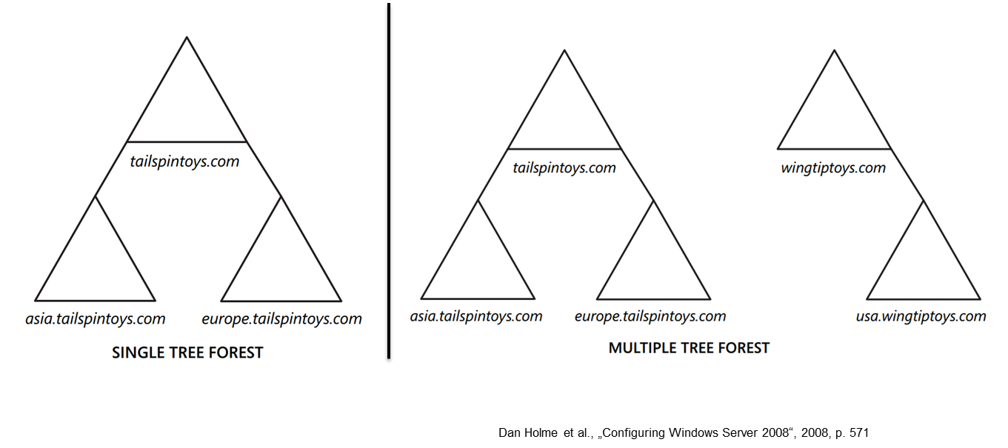
Active Directory Components
Active Directory data store
Domain controllers
Domain
Forest
Tree (DNS)
Organizational units and Sites
Group Policy

Slide 9
Active Directory Components
Active Directory data store
Domain controllers
Domain
Forest
Tree (DNS)
Organizational units and Sites
Group Policy
Organiational units are like folders in a file system; used to organize users, groups,…
Sites usually describe how a network looks like
DCs, Computers, Users,… can be allocated to a site
Usually these objects are in the same or in adjacent networks (subnet)
Sites can be used to make sure that a computer always contacts the nearest (in terms of network) DC and always uses the nearest services (regarding AD integrated services)

Slide 10
Active Directory Components
Active Directory data store
Domain controllers
Domain
Forest
Tree (DNS)
Organizational units and Sites
Group Policy
Group policy objects (GPO) can be seen as centrally managed settings, that either apply to a user or a computer
Group policies are managed from a central console (the Group Policy Management Console) and can be scoped to specific users, groups, organizational units and more
Most group policy settings eventually turn into a registry key that is set on the target computer

Slide 11
Active Directory Components
Active Directory data store
Domain controllers
Domain
Forest
Tree (DNS)
Organizational units and Sites
Group Policy
On every Windows computer, a dedicated service („Group Policy Client“) checks if there are new settings to be applied
Computer settings are applied on startup and every 90-120 minutes later
User settings are applied upon logon and every 90-120 minutes later

Slide 12
Active Directory Components
Active Directory data store
Domain controllers
Domain
Forest
Tree (DNS)
Organizational units and Sites
Group Policy
Every domain controller hosts a share that is readable by all domain users
\\DOMAINNAME\SYSVOL\DOMAINNAME\Policies
The „Policies“ folder inside the Sysvol share contains all group policies
Every policy is stored in a separate directory, named after the GUID of the policy
The folder can contain different files, depending on the GPO setting (.ini, .inf, .pol, .xml,…)
These files contain the actual configuration items

Slide 13
Reconnaissance
Enumerate all the things

Slide 14
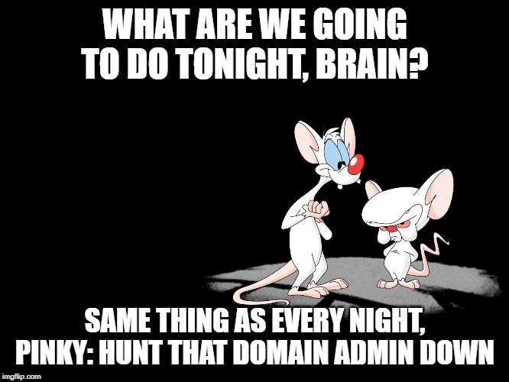
What do we want to know?
And where could we find it?

Slide 15
What do we want to know?
Domain Admins
Other privileged users (= server admin, helpdesk, developer,...)
Executives
Soft targets (Weak password, old passwords, passwords do not change, accounts that never logged in…)
Network mapping (based on AD sites, determine IP topology)
Group Policy (weak spots and protection mechanisms in place)
Software deployment (SCCM et Al.)
Services and service accounts
Delegation rights
And where could we find it?

Slide 16
Protocols
Most tools use the LDAP protocol (TCP 389) to enumerate AD which is the best choice in most cases because
Structured queries make it fast
Network traffic is encrypted if LDAPS (TCP 636) is available
LDAP log volume is VERY high, which makes it expensive for defenders to act on it
There is however also a legacy, SMB-based protocol called SAMR
It is slow, there aren’t many tools and you only get a limited set of results but it can be useful if firewall restrictions are in place
https://docs.microsoft.com/en-us/openspecs/windows_protocols/ms-samr/4df07fab-1bbc-452f-8e92-7853a3c7e380

Slide 17

Exercise 1: Reconnaissance
Photo by Daniel Cheung

Slide 18
Authentication-based Attacks
NTLM, Kerberos, oh my…

Slide 19
NTLM
Oh boy…

Slide 20
NTLM Intro
The term NTLM is often used synonymously for two different things
NTLM
as a part of the MS-NLMP authentication protocol, which is used to authenticate a user over the network
NTLM
the hash algorithm which is used to store a password on disk

Slide 21
NTLM Intro
MS-NLMP is a challenge-/response-based authentication scheme for authentication over the network
MS-NLMP is supported by various „transport“ protocols like SMB or HTTP
MS-NLMP includes
LM (Lan Manager)
NTLM (NT Lan Manager Version 1)
NTLMv2 (NT Lan Manager Version 2)

Slide 22
NTLM Summary
Protocol | Hash Algorithm | Used for | Security provided
LM | Pseudo-Hash based on DES encryption - very weak | Password storage Network authentication | Extremely weak
NTLMv1 | MD4 | Password storage Network authentication | Very weak
NTLMv2 | MD5 | Network authentication | Weak – yeah, that's the best we got :-(
Bottomline
All flavors of NTLM are old and weak and it would be best to not use them at all
However, this is a very complicated endeavor in real life due to compatibility problems ☹

Slide 23
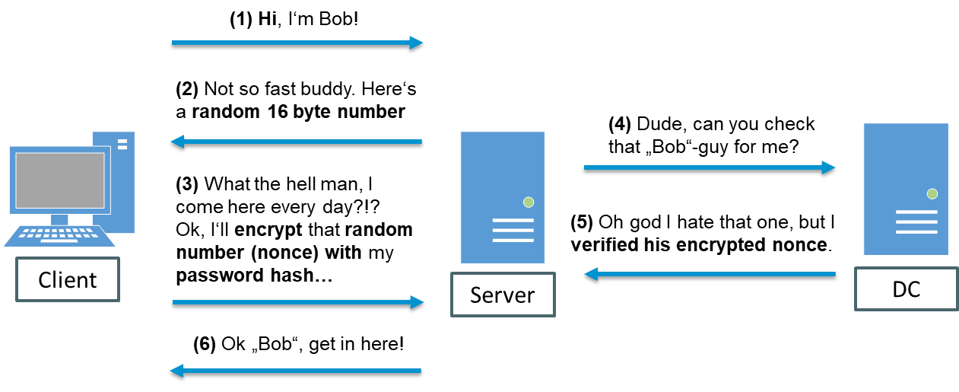
NTLM/MS-NLMP basic authentication flow

Slide 24
NTLM/MS-NLMP basic authentication flow
The client sends its username to the server
The server generates a random 16 byte number (challenge/nonce) and sends it to the client
The client encrypts the challenge with the hash of its password and sends the result to the server (this is the “response”, we’ll follow up on this in a minute)
The server sends the following three items to the Domain Controller for verification
Username
Challenge sent to the client
Response received from the client
The DC uses the username to retrieve the corresponding password hash from the AD database and encrypts the servers challenge
If the results match (the client's response and the response calculated by the DC), authentication is successful

Slide 25
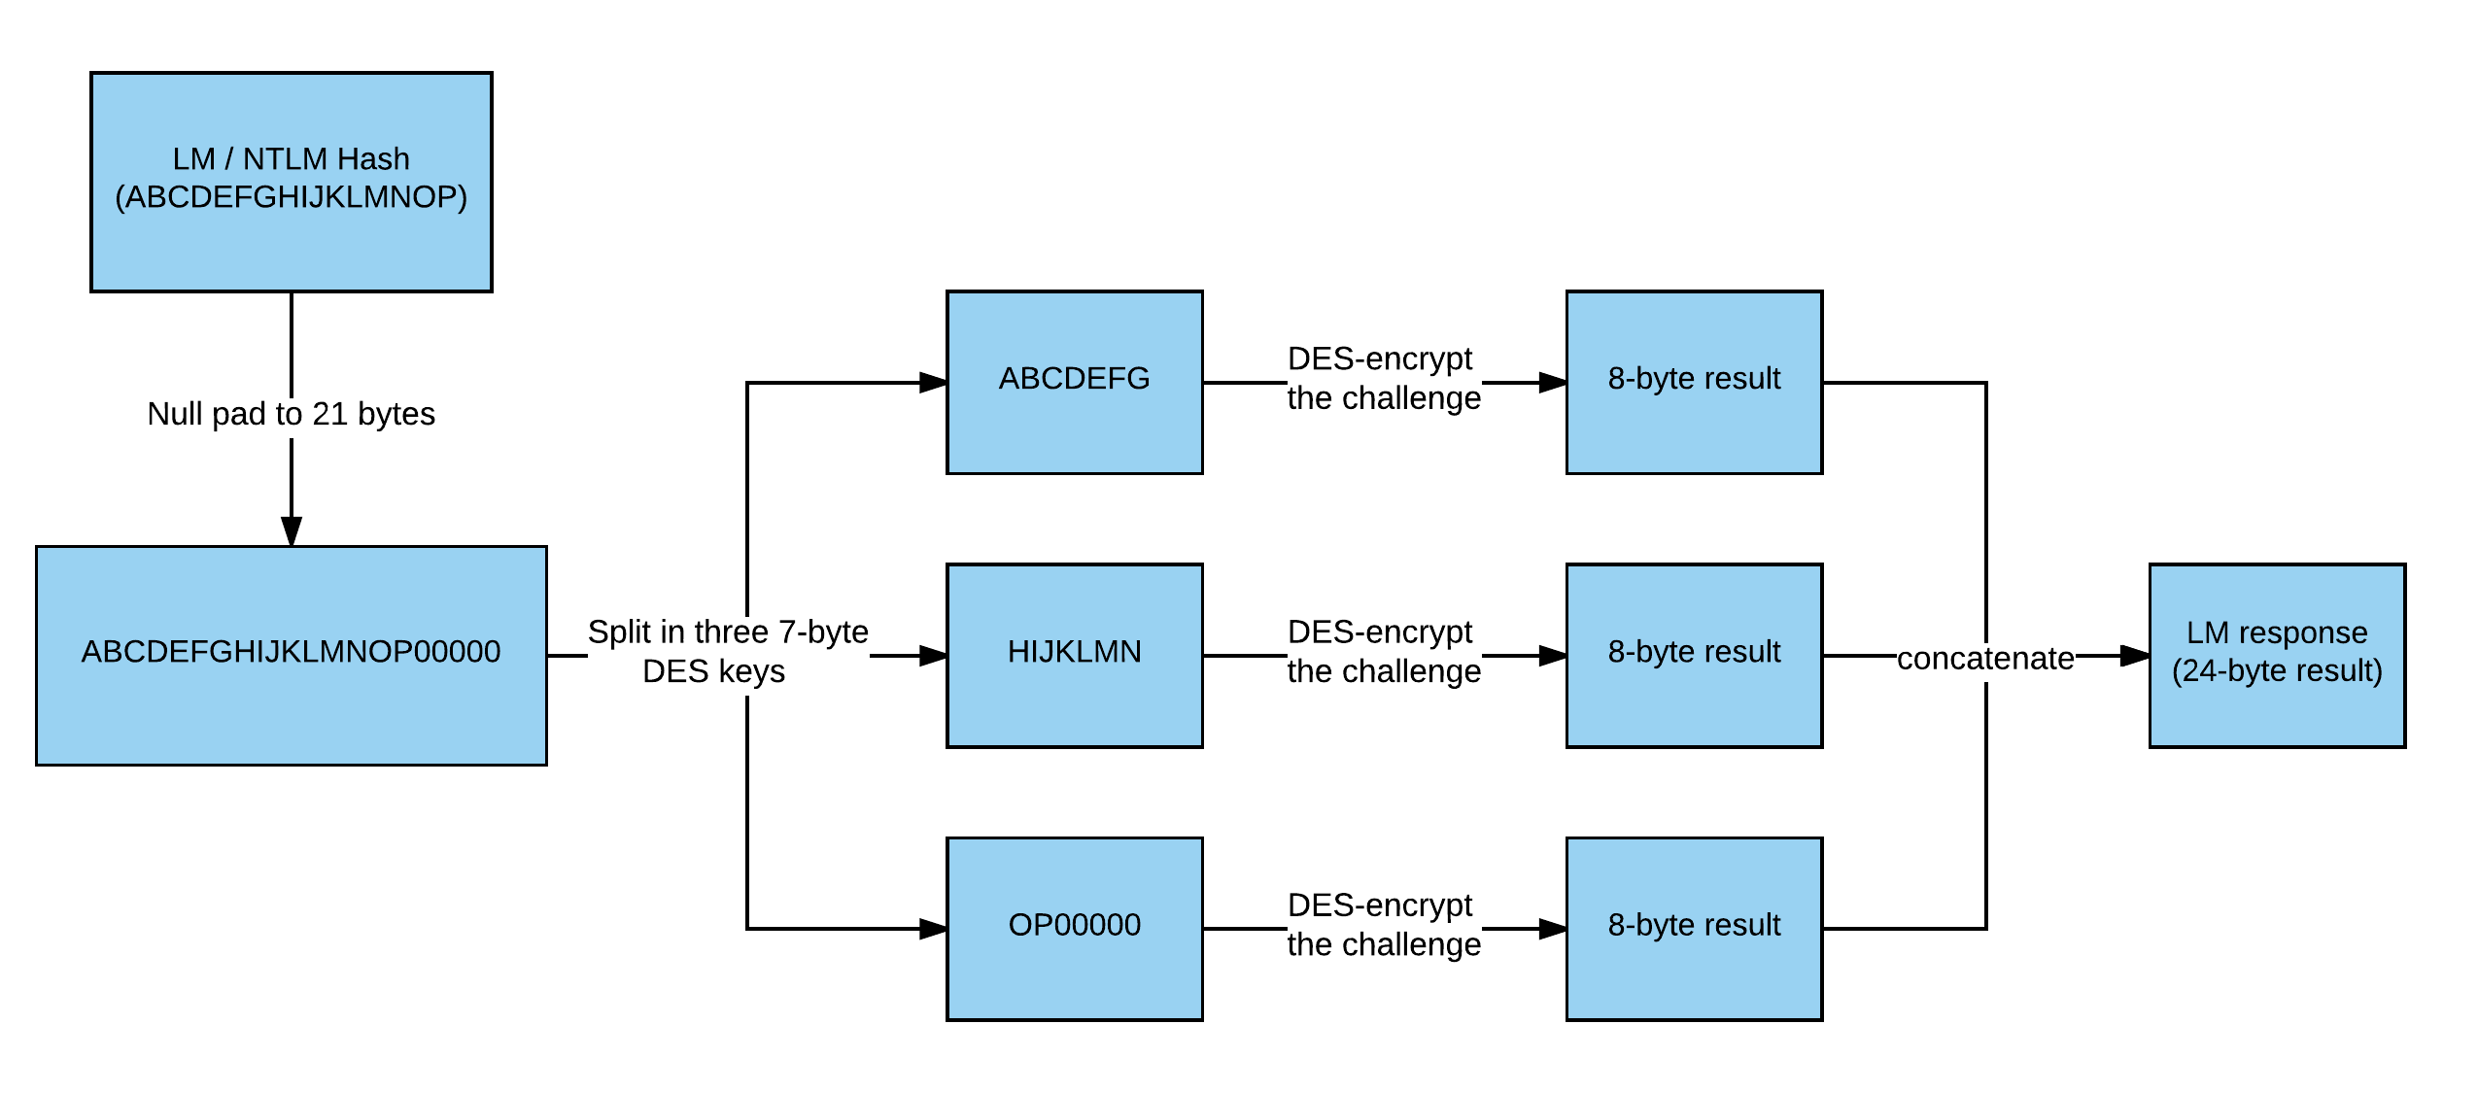
LM/NTLM Response
Please note: the hash values are strongly simplified for demonstration purposes and do not represent real values.

Slide 26
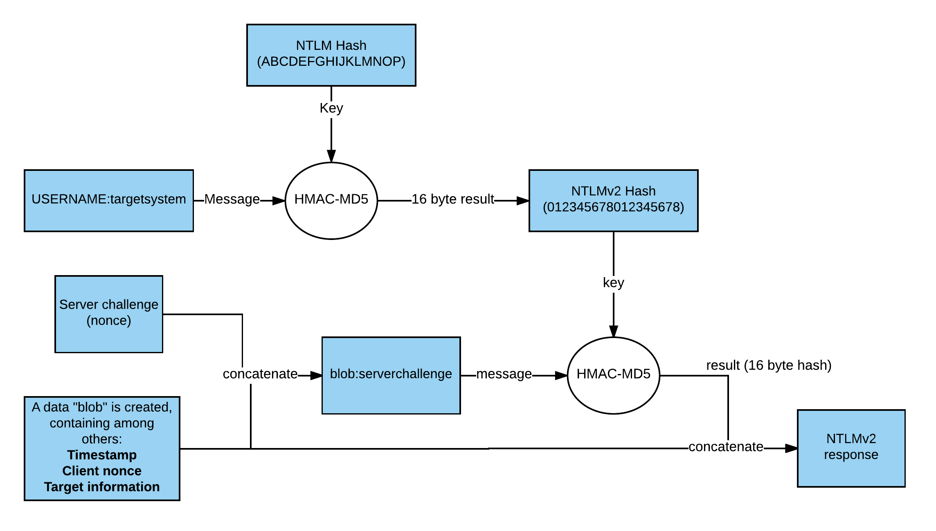
NTLMv2 Response
Please note: the hash values are strongly simplified for demonstration purposes and do not represent real values.

Slide 27
NTLM Attack Vectors in a Nutshell
Pass-the-Hash
Using the hash of a password without knowledge of the cleartext password to authenticate against other devices on the network.
Overpass-the-Hash
Get a Kerberos ticket from a NTLM hash, again without knowledge of the cleartext password.
Relay
Relay an incoming NTLM authentication attempt to another host. Mix of protocols possible.

Slide 28
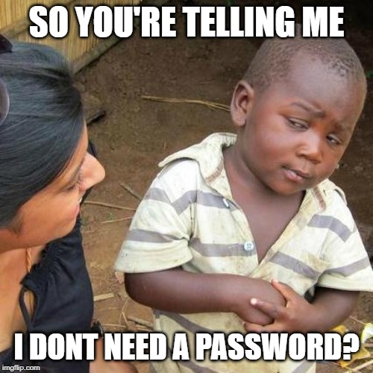
Pass-the-Hash Attack
The Pass-the-Hash attack abuses the previously described fact, that the password of the user is not required to successfully authenticate over the network, as long as the hash of the password is available
Cracking the password is no longer necessary(!)
Typical attack vectors are
Password hashes of local admin accounts, as long as they are identical across systems (e.g. all clients)
Hashes of privileged accounts (e.g. service accounts or administrators) acquired from memory

Slide 29
Exercise 2: NTLM
Photo by Daniel Cheung

Slide 30
NTLM Relay Attacks
NTLM is vulnerable to so called relay attacks
In a relay attack, the attacker redirects/relays an incoming authentication request from a higher privileged user (relay account) to another computer (relay target)
The attacker can then use the privileges of the relayed account to access the relay target

Slide 31
NTLM Relay Attacks
Due to the simplicity of the protocol, NTLM authentication is supported by various „transport protocols“
Therefore, NTLM relay is also possible in a cross-protocol fashion. E.g: incoming authentication via HTTP, outgoing authentication via SMB
Protocols that support NTLM are (among others)
LDAP
HTTP
SMB
SMTP
POP/IMAP

Slide 32
Common relay vectors
(1) Highly privileged service account "ServiceA" (typically with local admin rights) tries to access attackers host
(2) Attacker forwards incoming authentication to target host
(4) Original authentication request fails
(3) Attacker is successfully authenticated as "ServiceA"
IT Admin‘s Client
Server
Attacker
Scenario #1: Inventory tool queries clients remotely via SMB
Caveat: The attackers host needs to be a Linux machine because you can't disable the SMB service in Windows without wracking your host (feel free to try)

Slide 33
Common relay vectors
(1) Highly privileged user (e.g. Helpdesk user with local admin rights on clients) tries to access compromised host via SMB
(4) Attacker forwards incoming authentication to target host
(2) Attacker blocks SMB traffic
(5) Attacker is successfully authenticated as "ServiceA"
(3) Windows explorer automatically falls back to HTTP (Webdav)
IT Admin‘s Client
Helpdesk User or Admin
Compromised Client
Scenario #2: Helpdesk user tries to access a compromised host via SMB (using explorer.exe)
In this scenario, the attacker can operate on a compromised corporate machine because we mitigiate the SMB-caveat from the last scenario by redirecting the victim to HTTP

Slide 34
Common relay vectors
(1) Attacker introduces Man-in-the-Middle Scenario (WPAD, ARP, etc.)
(2) Attacker forwards incoming authentication to target host
(2) Victim authenticates against attackers host
(3) Attacker is successfully authenticated as "ServiceA"
IT Admin‘s Client
User
Attacker
Scenario #3: Man-in-the-Middle attack
Caveat: MitM-scenarios heavily depend on target configuration and network adjacency (e.g. same subnet)

Slide 35
Kerberos
The guard dog who protects the gate to the underworld

Slide 36
























Slide 37









This is Jack. Jack attends SecureCon – a conference for security experts.

Slide 38










Slide 39











Slide 40









Slide 41
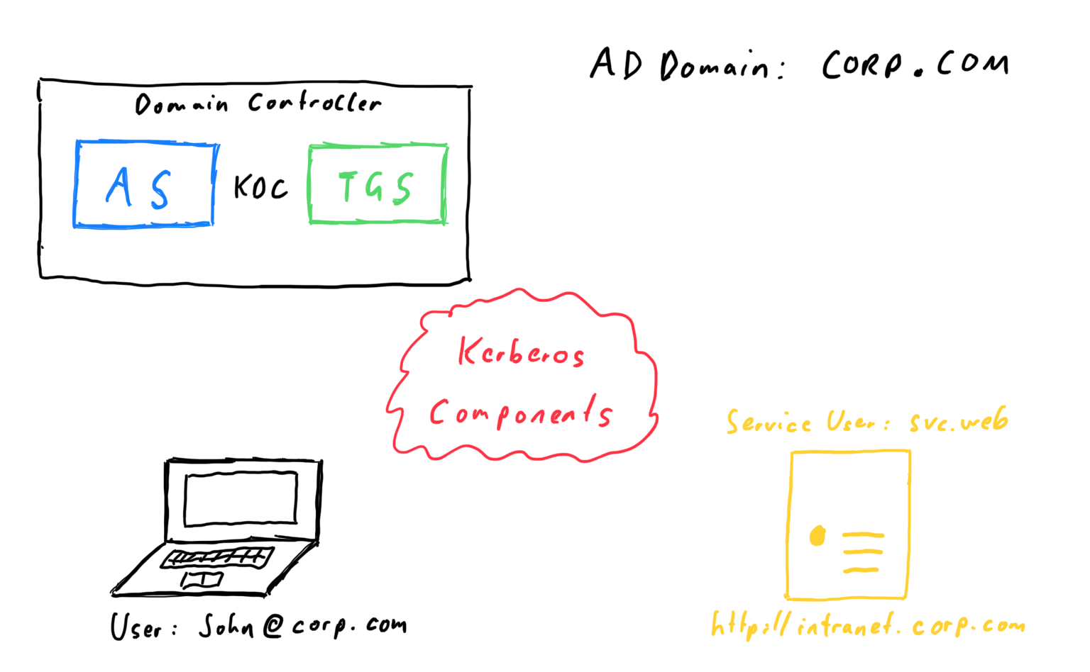
￼

Slide 42
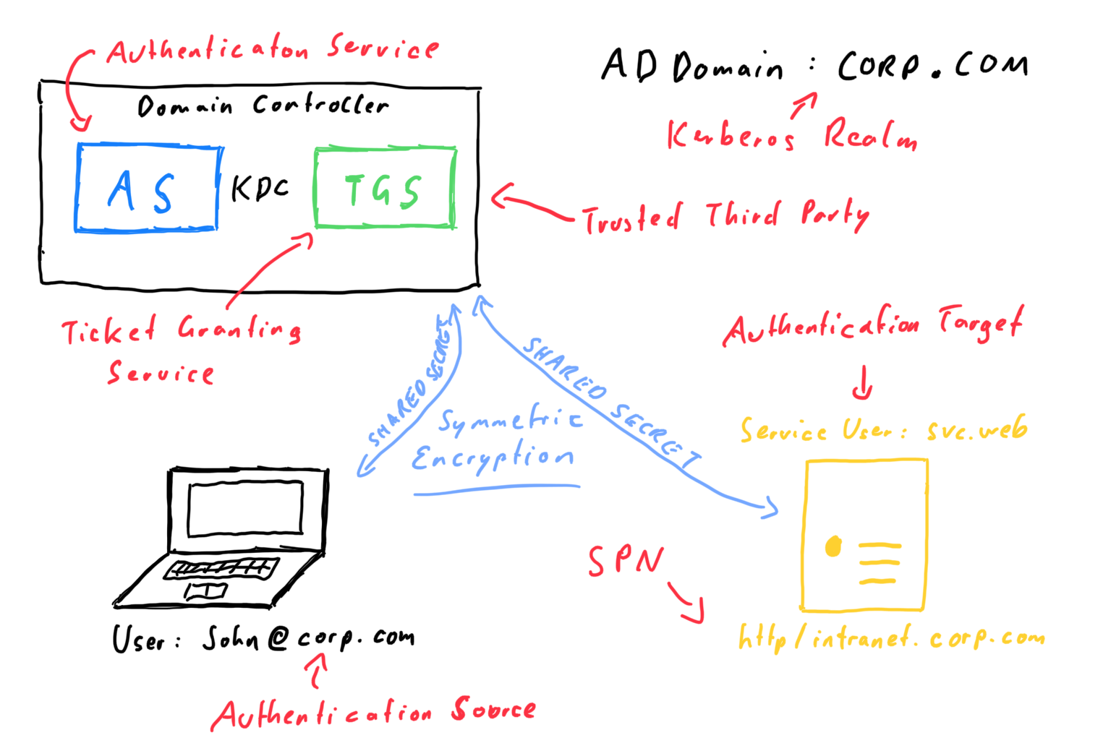

Slide 43
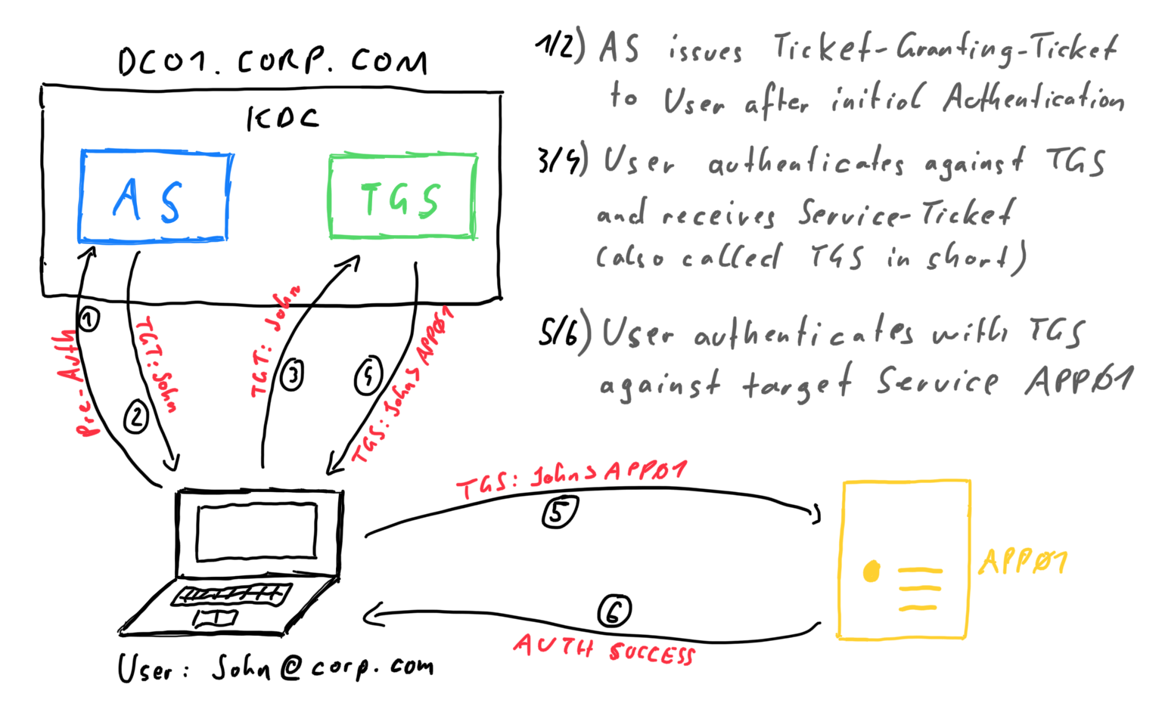
AS issues Ticket-Granting Ticket to User after initial Authentication
User authenticates againts TGS and receives Service-Ticket (also called TGS in short)
User authenticates with TGS against target Service APP01

Slide 44
Kerberos – Step by step
Step 1 - Authentication Service Request (AS-REQ)
First, the user authenticates against the authentication service (AS) of the KDC to get a valid ticket-granting ticket (TGT)
Initial request contains
UTC timestamp in the format YYYYMMDDHHMMSSZ
Encrypted with long-term key of the the user (long-term key is derived from password)
Encryption types depend on the Windows version
DES-CBC-CRC (disabled since Vista/2008)
DES-CBC-MD5 (disabled since Vista/2008)
RC4-HMAC (XP & 2003 default)
AES128-CTS-HMAC-SHA1-96 (introduced in Vista/2008)
AES256-CTS-HMAC-SHA1-96 (default since Vista/2008 and newer)

Slide 45
Kerberos – Step by step
Step 2 - Authentication Service Response (AS-REP)
If authentication is successful (correct and timestamp within tolerance), KDC issues a TGT to the user
Think of the TGT as a special form of service ticket
Contains Privilege Attribute Certificate (PAC)
Username
User, Group IDs
Group memberships
Encrypted with long-term key of the target service (!)
Since there is no dedicated target service for the TGT, the long-term key is the key of the „krbtgt“ account

Slide 46
Kerberos – Step by step
Step 3 – Ticket-Granting Service Request (TGS-REQ)
Client wants to access application / service an sends request to KDC
Contains TGT
Contains target service name (service principal name)
If the request is valid, a service ticket is issued (see step 4). Valid TGT means:
Encrypted with „krbtgt“ long-term key
Within time limits
Important
Kerberos authentication is „stateless“
KDC does not „know“ if a user was authenticated before
TGS „assumes“, that a user is authenticated if he can present a valid TGT
Validity of the TGT depends on the long-term key of the „krbtgt“ account

Slide 47
Kerberos – Step by step
Step 4 – Ticket-Granting Service Response (TGS-REP)
TGS (Ticket-Granting Service) issues service ticket for user
User information will be copied out of the PAC within in the TGT
Service ticket is encrypted with long-term key of the target service
Important
KDC does not know if a user has permission to access the target system (authentication vs. authorization)
Authorization has to be done by the target system

Slide 48
Kerberos – Step by step
Step 5 – Application Server Request (AP-REQ)
Target service decrypts service ticket with long-term key
Extracts user information from PAC
Checks permissions and decides access level
Optional: PAC can be cross-checked with KDC to make sure that the user information is correct
Important
PAC validation is typically not active due to performance reasons
If an attacker is able to obtain the service long-term key, then he can issue arbitrary service tickets, as long as the PAC is not validated

Slide 49
Kerberos – Step by step
Optional (Step 6 / 7)
Verify Service Ticket PAC (VERIFY-PAC)
Target service cross-validates PAC with KDC to verify user information
Typically not active due to performance reasons
Application Server Response (AP-REP)
User can request authentication of the target service in step 5 (Mutual authentication)
Service encrypts the timestamp with the session key, which should only be known by the user and the service and sends it back to the user for verification

Slide 50
Kerberos Attack Vectors in a Nutshell
ASREProasting
Offline password guessing against a user with disabled (default = on) Pre-Authentication
Pass-the-Ticket
Like PTH but with Tickets, still no knowledge about the cleartext password needed
Silver Ticket
Fake tickets against a single principal. Think: impersonate any User on one host
Golden Ticket
Fake tickets against the DC. Think: impersonate any User on all hosts in the domain
Delegation
Fake tickets by design against one or more hosts. Too complicated to explain in one sentence - more on this later ☺
Kerberoasting (TGSRoasting)
Offline password guessing against a ticket you grab from network or memory.

Slide 51
Kerberoasting (TGSroasting)
The service ticket the KDC issues (see TGS-REP) is encrypted with the long-term-key of the target principal
In case of RC4, the long-term-key is the NTLM hash of the users password
Therefore an attacker can:
Request a service ticket for any principal (any account with an SPN) with weak encryption (RC4)
Extract the ticket from memory (see PTT)
Run an offline attack on the accounts password (hashcat -m 13200)

Slide 52
Kerberoasting (TGSroasting)
Kerberoasting works best for service accounts
no one dares to touch them so they
rarely change passwords and
the passwords are often bad due to their age
Kerberoasting usually can not be applied against random users because a user object has no SPN by default
If you can modify a user object however (think: ACL), then you can apply targeted Kerberoasting ☺

Slide 53
Exercise 3: Kerberoasting
Photo by Daniel Cheung

Slide 54
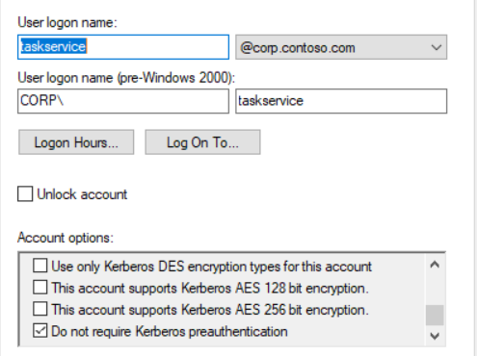
ASREProasting – oldy but goldy
Kerberos Pre-Authentication is turned on by default for all accounts, however it can be disabled on a per-user basis
If Pre-Authentication is disabled, an attacker can request a TGT for the target user and run an offline password guessing attack on the encrypted material in the ticket (hashcat -m 18200)
Can also be used in a targeted form if you have write-access on the object in Active Directory

Slide 55
Pass-the-Ticket (PTT)
Extracting the ticket (TGT/TGS) from memory and using it without knowledge of the cleartext password
Extraction and injection can be done without elevation if applied to your own logon session
Rubeus.exe dump
Rubeus.exe ptt /ticket:…
PTT vs. PTH
Kerberos is never disabled (like NTLM may be), so it always works
However a Kerberos TGT has a limited lifetime of about 10 hours (depending on GPO settings), whereas a password hash usually lasts for at least a month under real life conditions

Slide 56
Silver Ticket / Golden Ticket
Silver/Golden Tickets
Silver Ticket
Usually means faking tickets against a regular account – typically a service account due to SPN requirement
This means you can impersonate any account against that one account (or application that runs in the context of that account)
Golden Ticket
Means faking tickets against the krbtgt account, which allows an attacker to create arbitrary TGTs
describe a scenario in which an attacker acquires a password or a password hash of an account and can therefore fake tickets against that account

Slide 57
Silver Ticket
Compromise a password or hash of an account and impersonate any User via Kerberos against that account
Example
An MSSQL Server uses a domain account to run the SQL service
An attacker gets access to the password hash of the account
The attacker can now create a valid service ticket, impersonating a Domain Admin, for the sql account

Slide 58
Golden Ticket
Compromise the password of the krbtgt account and impersonate any user against any host in the domain
Example
An attacker can access the AD Database on a DC and acquire the krbtgt-hash
The attacker can now create a valid TGT for the Domain Administrator (500)
Due to the valid TGT, the attacker can request service tickets for any principal using the normal procedure
Therefore, the attacker can access any domain member as Domain Admin

Slide 59
Delegation
Delegation allows a principal (typically an application or server) to act on behalf of another principal (typically a user)
The delegation features in Active Directory have been added to the Kerberos protocol as an extension called MS-SFU (S4U) as documented here
https://docs.microsoft.com/en-us/openspecs/windows_protocols/ms-sfu
In a nutshell, there are three different types
Unconstrained
Constrained
Resource-based Constrained (we will not cover this due to time constrains)

Slide 60
Unconstrained Delegation
User01 authenticates against a computer SRV01, which is enabled for unconstrained delegation and requests a service ticket for that computer
The domain controller places a copy of the user’s TGT into the service ticket that is returned to the user
The users sends the service ticket to the computer
The computer can decrypt the ticket and is in possession of the users TGT – therefore, the computer can now impersonate the user without any constrains ( == unconstrained)

Slide 61
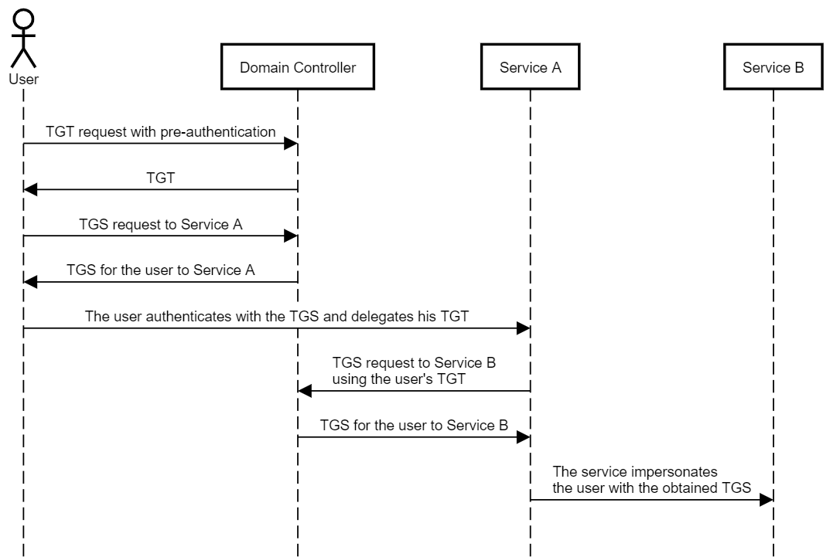
https://shenaniganslabs.io/2019/01/28/Wagging-the-Dog.html

Slide 62
Unconstrained Delegation
Unconstrained delegation is very powerful since you can impersonate any user (possibly also an administrator) as long as you get them to authenticate against you (think: Print Spooler Bug)
The only exception are accounts that are
marked as sensitive for delegation
members of the “Protected Users” group
Microsofts recommends guarding any host enabled for unconstrained delegation like you would guard a DC

Slide 63
Unconstrained Delegation
Unconstrained delegation is controlled with the flag ADS_UF_TRUSTED_FOR_DELEGATION in the userAccountControl attribute
It can be enabled for user and computer objects
Use Powerviews "Get-DomainComputer" or "Get-DomainUser" with the “-Unconstrained” parameter to identify these objects

Slide 64
Constrained Delegation
Since unconstrained delegation might be too unconstrained in many scenarios, Microsoft implemented constrained delegation to allow more control over the delegation process
Constrained delegation consists of two features
S4U2Proxy
S4U2Self
Classic constrained delegation is configured outbound (on the principal that is allowed to delegate)

Slide 65
Constrained Delegation / S4U2Proxy
User01 authenticates against a computer SRV01 which is enabled for constrained delegation and requests a service ticket for that computer
SRV01 is allowed to delegate to another computer called SRV02
SRV01 can present the service ticket for himself from User01 to the authentication service and get a new service ticket for User01 to SRV02
SRV01 can take the service ticket to impersonate User01 against SRV02

Slide 66
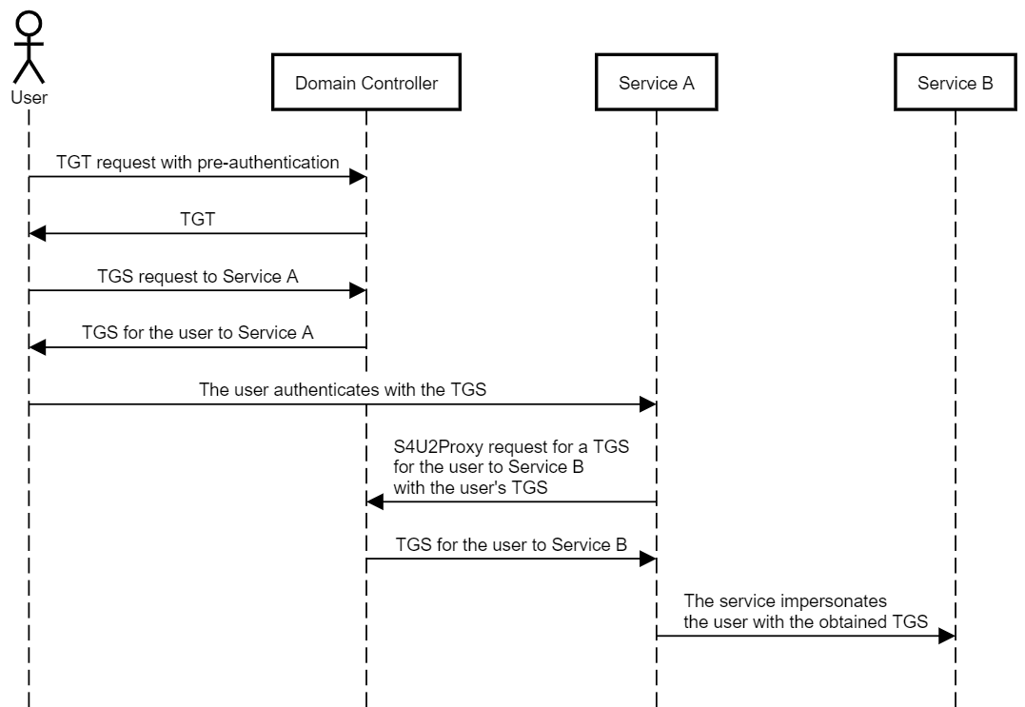
S4U2Proxy
https://shenaniganslabs.io/2019/01/28/Wagging-the-Dog.html

Slide 67
Constrained Delegation / S4U2Self
Since users might authenticate via many different protocols other than Kerberos (e.g. web form, basic, ntlm,…) the S4U2Self allows a so called protocol transition
What does “protocol transition” mean exactly?
A host invoking S4U2Self basically requests a service ticket for a random user to itself from the authentication service
The host then uses this very service ticket as an input for the S4U2Proxy process
However there is no way for the DC to verify if the user really authenticated against the host in the first place (!)

Slide 68
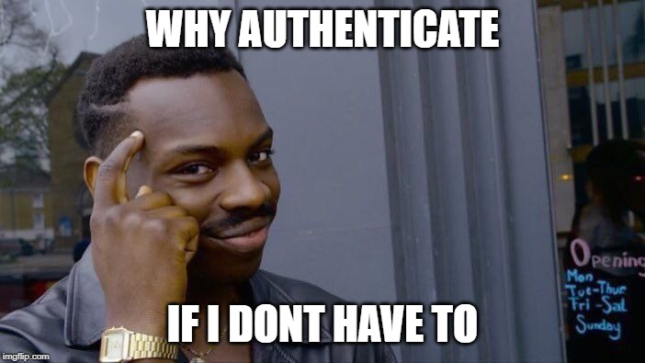
Constrained Delegation / S4U2Self
Since users might authenticate via many different protocols other than Kerberos (e.g. web form, basic, ntlm,…) the S4U2Self allows a so called protocol transition
What does “protocol transition” mean exactly?
A host invoking S4U2Self basically requests a service ticket for a random user to itself from the authentication service
The host then uses this very service ticket as an input for the S4U2Proxy process
However there is no way for the DC to verify if the user really authenticated against the host in the first place (!)

Slide 69
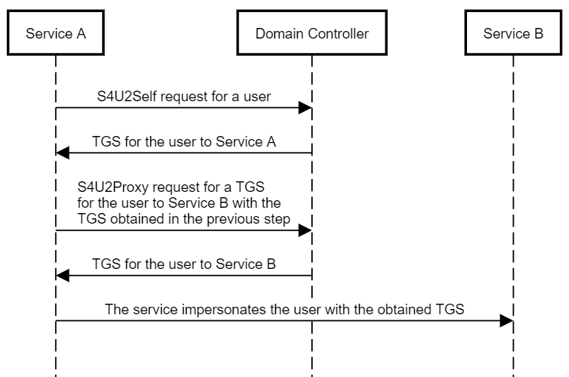
https://shenaniganslabs.io/2019/01/28/Wagging-the-Dog.html

Slide 70
Constrained Delegation
S4U2Proxy/S4U2Self are controlled with two attributes
The userAccountControl flag TRUSTED_TO_AUTH_FOR_DELEGATION needs to be set and
the attribute msds-allowedtodelegateto should contain the list of allowed delegation targets in the form of SPNs (e.g. HTTP/host.domain.com)
Only if the TRUSTED_TO_AUTH_FOR_DELEGATION flag is set, the DC returns a forwardable ticket when invoking S4U2Self and a forwardable ticket is necessary to successfully invoke S4U2Proxy

Slide 71
Exercise 4: Delegation
Photo by Daniel Cheung

Slide 72
ACL-based Attacks
An ACE up your sleeve

Slide 73
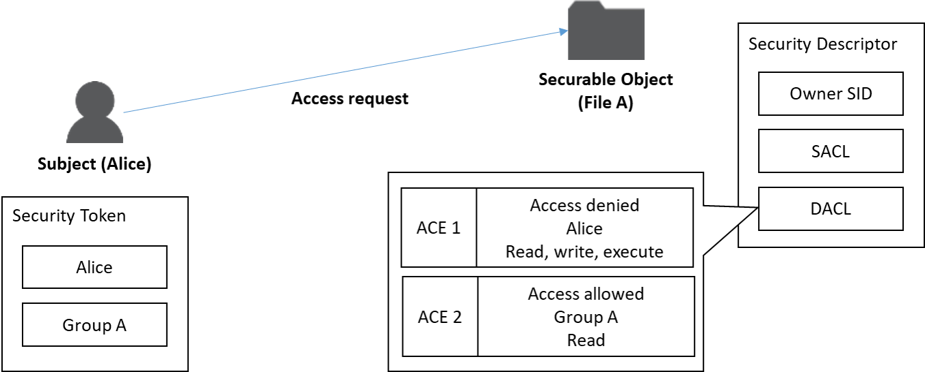
Quick Recap – Access Control Basics

Slide 74
Access Control in Active Directory
Key facts
Every object in Active Directory (User, Computer, OU,…) has an Access Control List (ACL)
ACLs can be used for security or auditing
ACLs contain Access Control Entries (ACE)
ACEs match principals to access rights and either Allow or Deny access
ACEs can be inherited through the „folder“-structure of Active Directory (which means Domain, OUs)

Slide 75
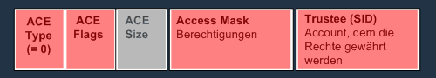
Access Control in Active Directory
You can give access based on different types of access rights defined in the Access Control Mask of the ACE
https://docs.microsoft.com/en-us/windows/win32/api/iads/ne-iads-ads_rights_enum
Simply spoken, there are simple and complex access rights. A simple ACE looks like this
http://www.selfadsi.de/deep-inside/ad-security-descriptors.htm#ACEInheritedTypeGUID

Slide 76
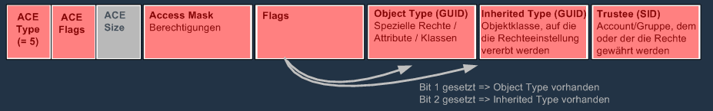
Access Control in Active Directory
A complex access right allows to further restrict access to a certain attribute or a group of attributes.
These attributes are defined by the field “object type/object ace type”
An example of a complex right is the “Send-As” permission
http://www.selfadsi.de/deep-inside/ad-security-descriptors.htm#ACEInheritedTypeGUID

Slide 77
ACL-based vectors
ACL-based vectors abuse ACL misconfigurations to elevate privileges
Based on what type of object you have access to, different techniques can be used
User: reset the users password or apply targeted kerberoasting
Computer: use RBCD to get admin
Group Policy: deploy logon script, install service...endless possibilities ;-)
The best tool to analyse ACLs in large environments is Bloodhound

Slide 78

What‘s Bloodhound?
Bloodhound uses Neo4j, a graph database, to find relationships between AD objects that can be used to escalate privileges
Through the power of graph theory, bloodhound can find „attack paths“ that are complex and difficult to identify with tools like PowerView or similar
Bloodhound is also an excellent tool for defenders to regularly test and reduce the attack surface

Slide 79
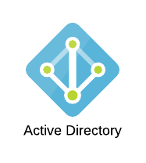






How it works
Powershell library for direct DB access
Cypherdog
Neo4j Graph DB
LDAP queries (users, computers, groups, ACLs,...)
UI app imports JSON files into neo4j DB...
...and allows for easy querying
C# data collector for bloodhound
Bloodhound.exe (UI)
Sharphound
ZIPed JSON files
Windows desktop application (single page .JS based on Electron)
Bloodhound User

Slide 80
Exercise 5: ACL-based attacks
Photo by Daniel Cheung

Slide 81
Persistence
I am the Domain Controller

Slide 82
What‘s Persistence?
Persistence describes a way for the attacker to keep its access and the acquired privileges for a longer timeframe
The simples form of persistence in Active Directory can be the knowledge of a privileged accounts password, though this will usually not hold longer than a couple of months, due to password policy
From an attackers point of view, a good persistence method
is not easily revoked or identified by the sysadmin/security team
provides long-term access (6 months or more) to the environment

Slide 83
ACL-backdoors
ACL-backdoors refer to a general class of persistence methods using manipulated ACLs on directory objects
Common examples for ACL backdoors are
Write access on a highly privileged group, which allows an attacker to add/remove himself to/from the group as desired
Write access on a group policy object, which allows an attacker to run code as system on affected computer objects
Write access on a computer object, which allows an attacker to gain admin privileges on that machine through resource-based constrained delegation

Slide 84
DCSync
This allows an attacker to replicate content from the Active Directory database like a regular Domain Controller does
The attacker has access to the password hashes of all accounts in the domain and can impersonate them using other techniques like Pass-the-Hash/Overpass-the-Hash
The so called „DCSync privilege“ actually consists of two different rights that need to be granted in the ACL of the domain object
Replicating Directory Changes
Replicating Directory Changes All

Slide 85
Golden Ticket
Golden Tickets are crafted TGTs with arbitrary usernames and group-memerships (e.g. domain admins, enterprise admins,…).
Since they rely on the password hash of the krbtgt account, golden tickets usually have a very long lifetime (at least one year).
The krbtgt-hash is not changed automatically. This has to be initiated by the sysadmins, who usually are very reluctant to do that due to possible availability issues.

Slide 86
Exercise 6: Persistence
Photo by Daniel Cheung

Slide 87

Before we move on…
Time for Q&A
Photo by Daniel Cheung

